Slide 1
The value of high-resolution radiosonde data in
Planetary Boundary Layer Studies
Dian Seidel
NOAA Air Resources Laboratory
College Park, Maryland
With major contributions from Yehui Zhang
Workshop on Research Applications of High-Resolution Radiosonde Data
27-29 May 2013 Stony Brook University

Slide 2
Topics
Motivations for PBL studies
Suitability of raobs for PBL studies
Dependence of PBL parameters on vertical resolution
Effects of vertical resolution changes on apparent PBL trends

Slide 3
Motivations for PBL Studies
Importance of PBL processes in climate
  Climate feedbacks involving surface fluxes
  Carbon cycle
  Vertical profile of temperature trends
Air quality applications
Limited observational analyses for model evaluation

Slide 4
Many Ways to Characterize the PBL
Thermodynamic profiles
Wind profiles
Derived quantities (incl. dimensionless ratios)
Inversions, inflection points, threshold values
Concentrations of trace constituents
Cloud bases, tops
Atmospheric turbulence parameters, surface roughness characteristics
Not all are measured by or derivable from raobs

Slide 5
PBL Heights Based on Vertical Profile Data
Sounding from Lerwick, UK 2300 UTC 23 December 2006
Vertical profiles of 6 variables
Estimated PBL heights -- dashed horizontal lines
PBL height depends on selected variable, vertical resolution of data

Slide 6
Complex planetary boundary layer structures
2000
Free Atmosphere
Height (m)
Mixing Height
Stable (Nocturnal) Boundary Layer
0
Noon
Sunset
Midnight
Sunrise
Noon
Figure from Stull (1988)
Local Time
Surface-Based Inversion (SBI)

Slide 7
Global Radiosonde Network
Integrated Global Radiosonde Archive (Durre et al. 2006, Durre and Yin 2008 )
1999-2008 data from 505 stations with
  reasonably complete records (at least 50% of expected obs)
  decent vertical resolution (min 10 levels between sfc and 500 hPa)
44 U.S. stations with high (~35m) resolution data

Slide 8
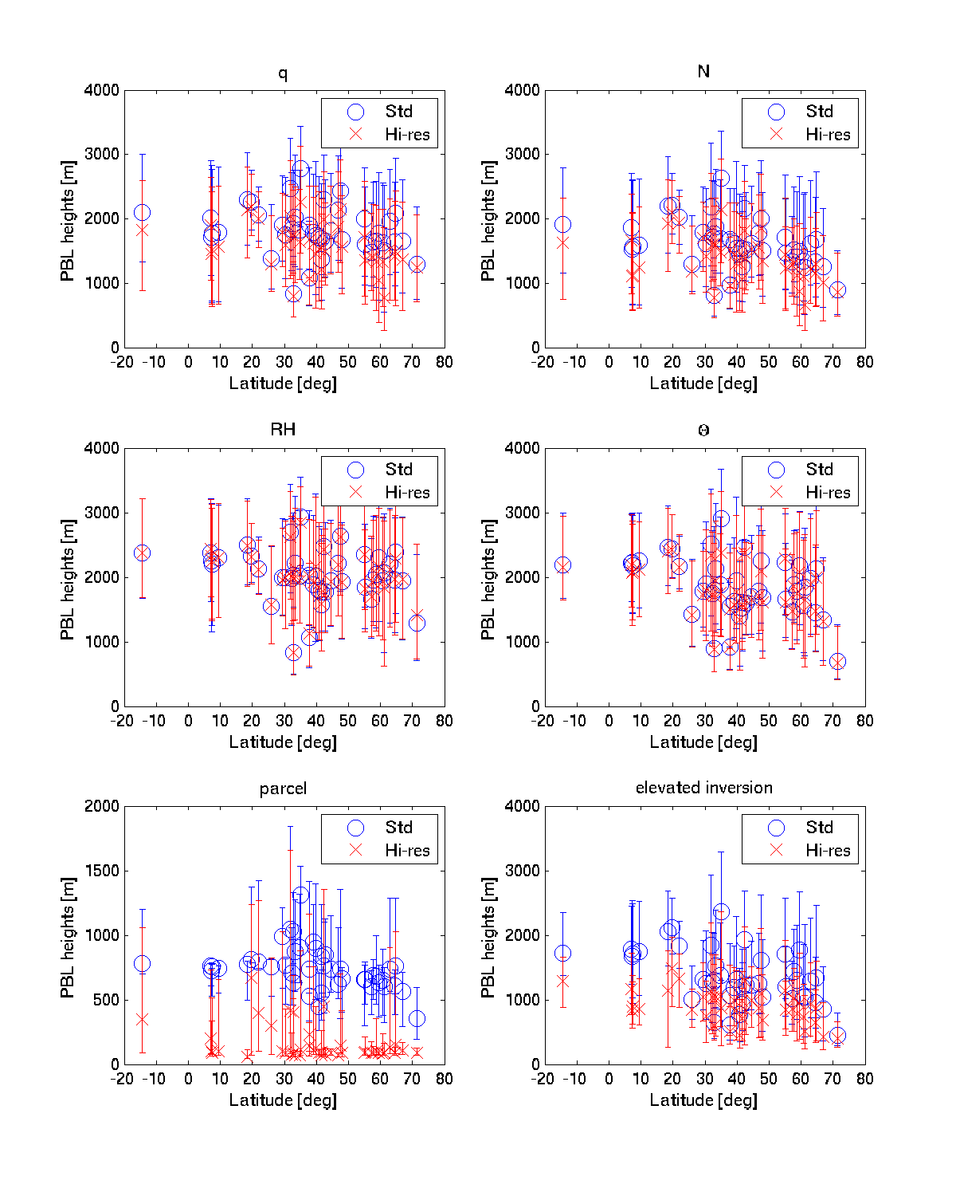
Effect of Sounding Vertical Resolution
Max vert. pot. temp. gradient
25th, 50th, and 75th percentile values of PBL height using all soundings during 1999-2007 from 44 stations
High (35 m) resolution data from SPARC Data Center
Standard resolution data from NOAA/NCDC/IGRA
We required 10 levels below 500 hPa; 6 are mandatory; soundings had 11-34
Elevated temperature inversion

Slide 9
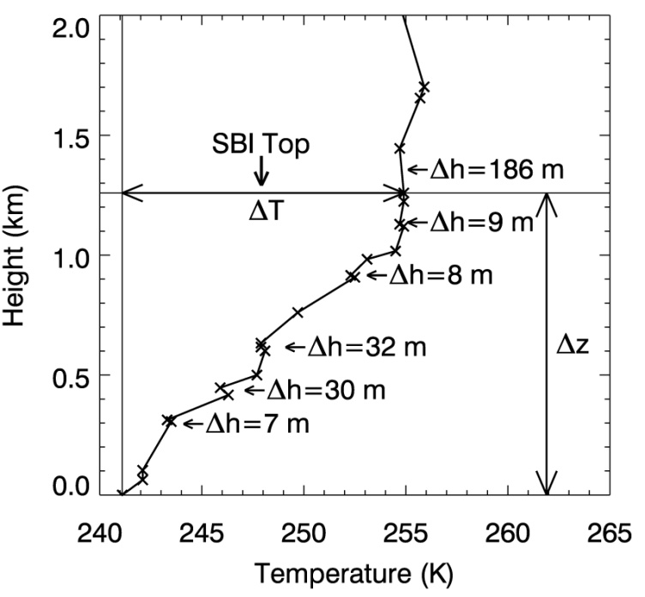
Surface-Based Inversions (SBI)
SBIs are common in polar regions, wintertime
SBI Parameters:
  Depth → ∆z
  Intensity → ∆T
Sounding resolution determines
  SBI top
  Embedded layers
SBI identification may depend on location of surface observations
Sample temperature profile from Alert, Canada (82N, 62W) at 1200 UTC 14 February 2009
  ∆h → Embedded non-inversion layers

Slide 10
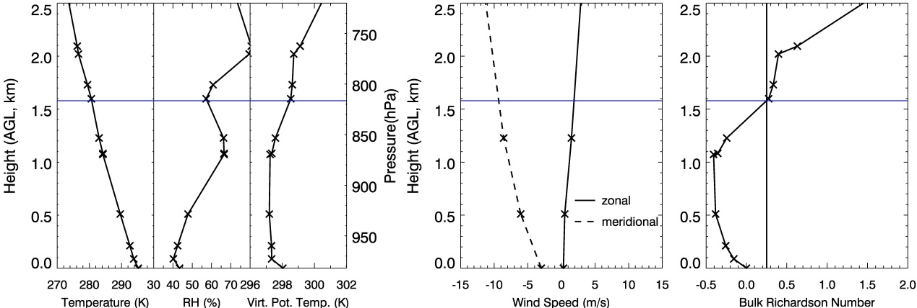
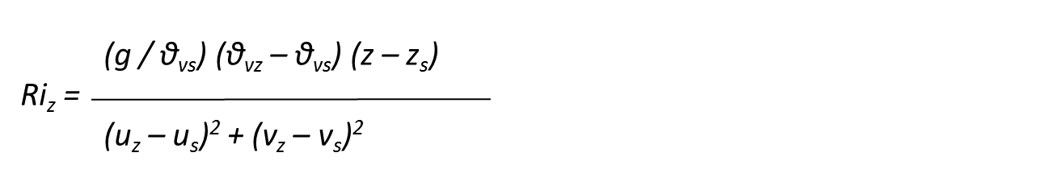
PBL Mixing Height
0000 UTC 28 June 2006 Minneapolis, Minnesota (45N, 94W)
T RH θ_{v} Wind Speed Bulk Ri
“Mixing Height”
Note mismatch of
wind and PTU data
Notes:
Sample from Minneapolis, MN, 0000 UTC 28 June 2006.
X – radiosonde data levels.
Search for Ri=0.25 goes from surface upward.
0.25 values doesn’t fall at observed level, interpolation required, depends on vertical resolution.
We have explored uncertainty associated with these issues.

Slide 11
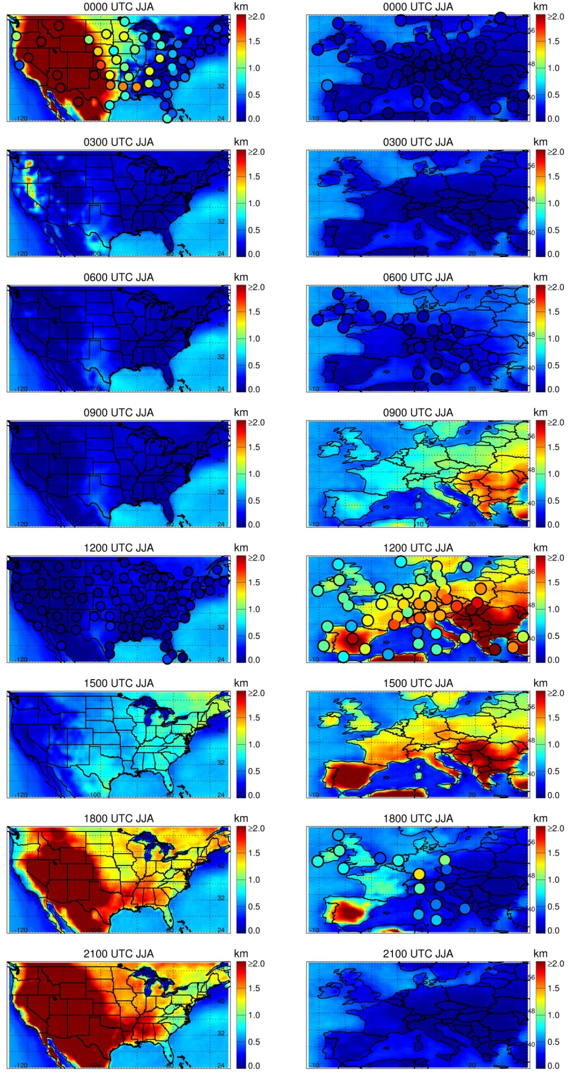
Summertime Mixing Height Diurnal Cycle
Radiosondes (2/day) superposed on ERA-Interim (8/day)
Notes:
Watch US again.

Slide 12
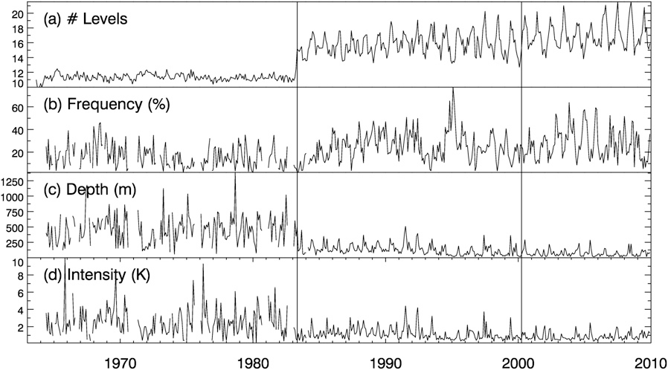
Sounding Resolution Affects SBI Characteristics
1983 Changes In
Average Values
11 → 16 levels
16 → 25 %
456 → 131 m
2.5 → 1.2 K
SBI characteristics at Jan Mayen, Norway (71N, 9W), 1963-2009
1983 increase in vertical resolution of soundings

Slide 13
Suitability of Raobs for PBL Studies
REPORT CARD
Subject | Grade
Measurement of relevant parameters | B
Resolution of diurnal variations | D
Spatial sampling of the globe | D
Coincident surface and upper-air information | C
Length of observational record | A
Vertical resolution (and co-location of parameters) | B to F
Homogeneity of data archive | C
GRADE POINT AVERAGE | ?

Slide 14
Value of High Resolution Raob Data
Better resolution of small-scale structures within the PBL, including cloud layers
More confident identification of surface-based inversions
Closer co-location of wind and temperature data allows more accurate calculation of Richardson number, etc.

Slide 15
Thank you!

Slide 16
Publications
Estimating climatological planetary boundary layer heights from radiosonde observations: Comparison of methods and uncertainty analysis. Seidel et al. (JGR 2010)
Climatological characteristics of Arctic and Antarctic surface-based inversions. Zhang et al. (J. Climate 2011)
Challenges in estimating trends in Arctic surface-based inversions from radiosonde data. Zhang and Seidel (GRL 2011)
Climatology of the planetary boundary layer over the continental U.S. and Europe. Seidel et al. (JGR 2012)

Slide 17
Extras
PBL

Slide 18
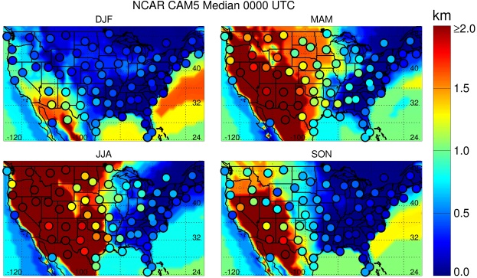
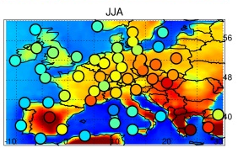
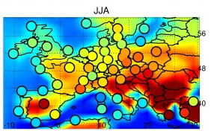
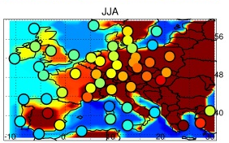
Daytime Summertime “Mixing Heights”
ERA-Interim GFDL AM3 NCAR CAM5
Reanalysis Climate Model Climate Model
Dots: Radiosonde Data
Notes:
Again, models match pattern of observations.
High MH in NCAR model especially notable in Eastern Europe.
Little observational basis for validation due to spotty radiosonde programs in FSU post 1990.

Slide 19
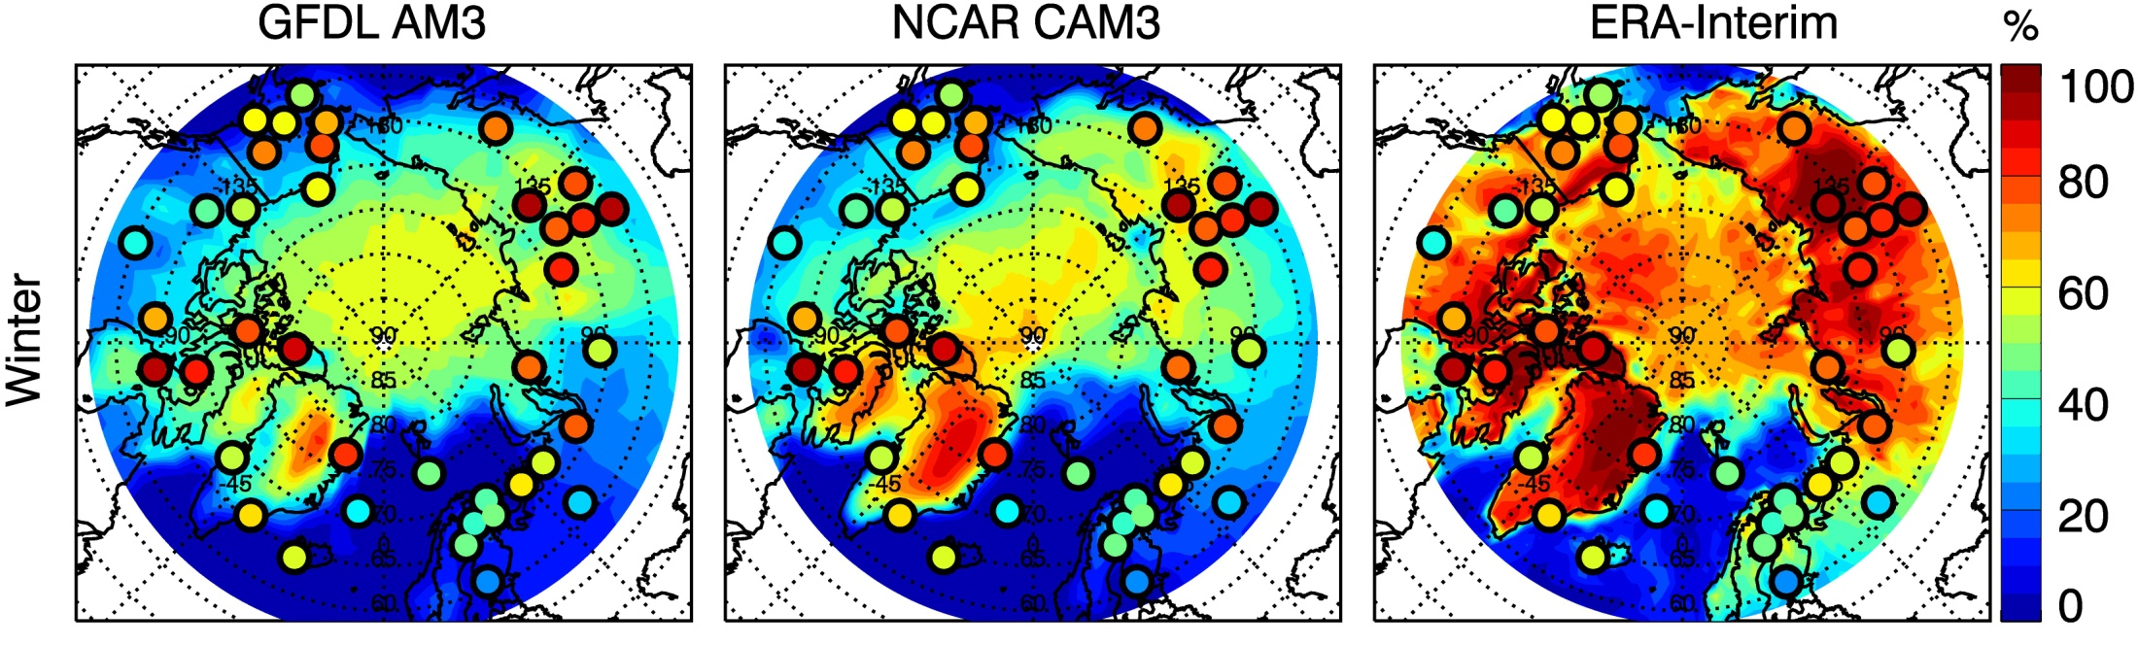
Obs/Model Comparisons: SBI Frequency in Winter
Similar spatial distributions (and seasonal patterns)
ERA-Interim agrees well with (assimilated) observations
Climate models underestimate SBI frequency
ERA-Interim shows higher Arctic Ocean SBI frequency than climate models

Slide 20
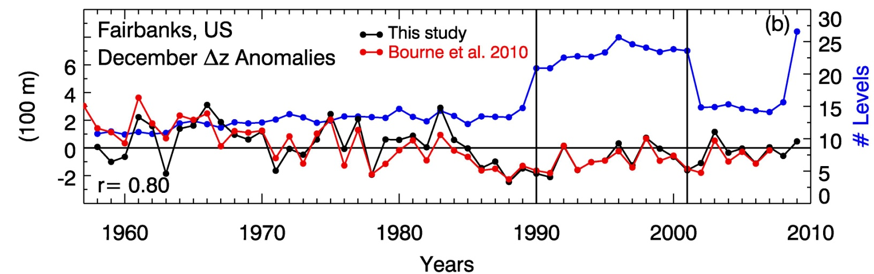
Trends in Arctic SBIs
Previous studies report inconsistent results for limited regions (Bradley et al. 1993, Walden et al. 1996, Kahl et al. 1996, Bourne et al. 2010)
Most ignore data homogeneity, so trends are suspect
Of 113 stations, we judged 19 homogeneous for 1990-2009

Slide 21
Extras
Tropopause

Slide 22
Trends in Tropical Cold-Point Tropopause
James S. Wang, Dian J. Seidel, and Melissa Free, 2012: How well do we know recent climate trends at the tropical tropopause? J. Geophys. Res., 117, D09118, doi:10.1029/2012JD017444.

Slide 23
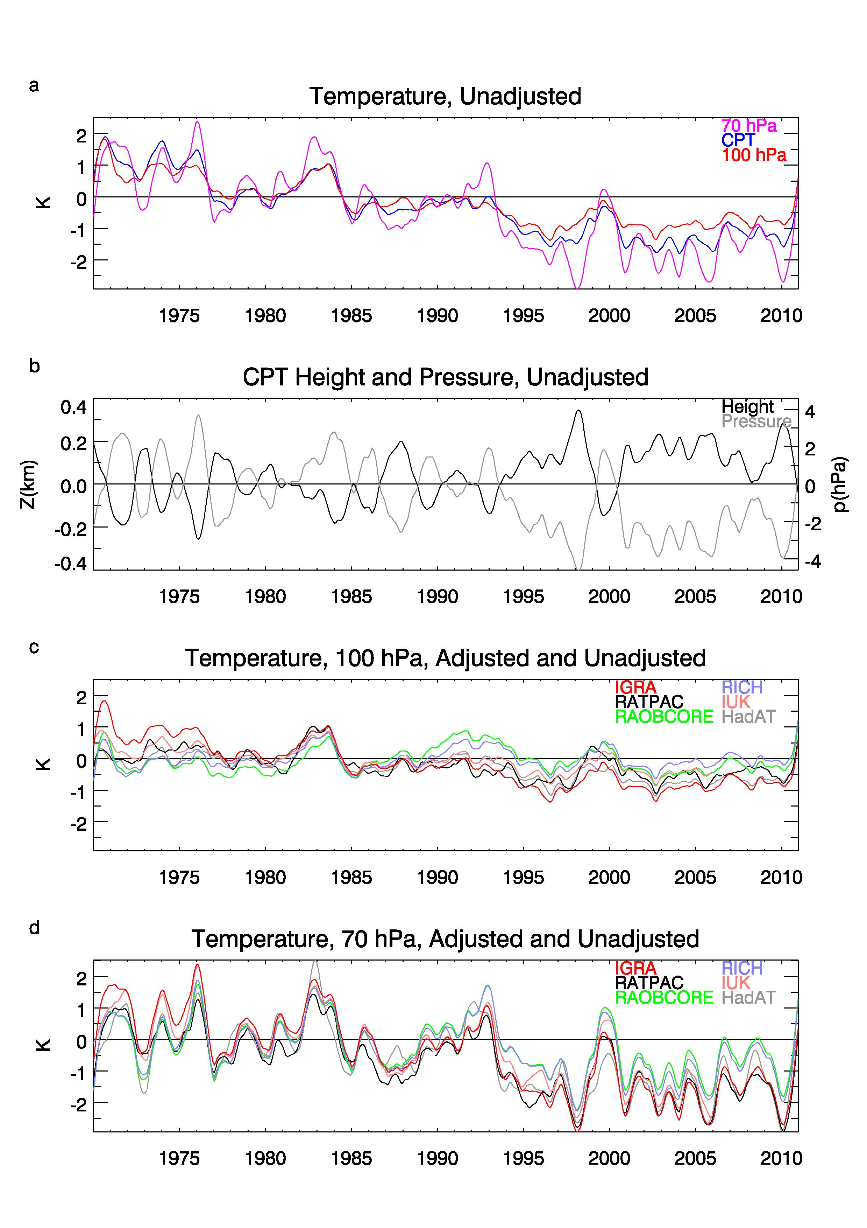
Tropical average T near tropopause
70 hPa
100 hPa
CPT
Cold Point Tropopause (CPT) and 70 and 100 hPa
Variations are similar
All show (real and/or spurious) cooling
Notes:
--Stations with fewer than 1/3 of monthly data missing during period (consistent with trend analysis) (and select non-gappy during 2000-2001 too).
--Divide tropics into 3 equal regions, averaging the 3 regional averages to calculate global avg. Purpose was to give equal weight to regions with varying data coverage.
--Monthly anomalies, smoothed
--Tropical tropopause an important region of atmosphere for global climate and atmospheric chemistry.
--Time series of T averaged over a set of tropical radiosonde stations at 100 hPa and 70 hPa, which are close to the tropical tropopause.
--CPT is point of minimum T; (location varies but generally between 100 hPa and 70 hPa in tropics or ~17 km).
--Since previous studies of CPT trends generally didn’t account for time-varying biases, we estimated adjusted trend…
--We found CPT trend more uncertain and less negative than previously estimated.

Slide 24
Adjustments reduce 100 hPa cooling
Unadjusted data in red
5 approaches to removing time-varying biases
Cooling reduced, also at 70 hPa
Adjusted datasets only available for mandatory pressure levels, not CPT
Notes:
--(2000 drop) As described in previous studies.

Slide 25
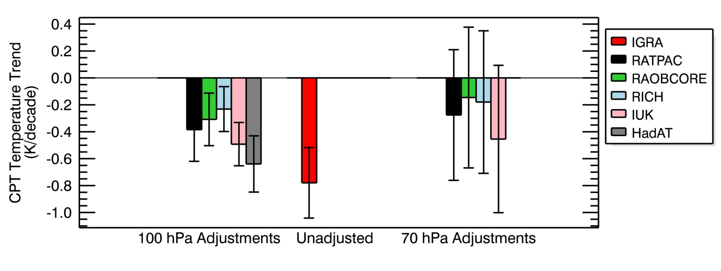
Adjusted CPT Trends:
Nearby Level Approach
Wide range of trends (uncertainty)
Adjustments reduce CPT cooling
Notes:
--I.e. no significant cooling at CPT for some adjustments.

